Slide 1
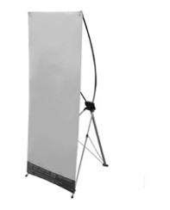
Paper ID goes here
Title Goes Here Title Goes Here Title Goes Here Title Goes Here
Affiliation’s Logo
Goes here if any
Author’s Name/s Goes Here, Author’s Name/s Goes Here
Address/es Go Here
Instruction
Use the “copy” and “paste” command to create the correct number of copies of the blue section headers.
Materials Provided by the Organizer:
1) X Racks & Base Fabric Canvases (160 cm × 60 cm)
2) Adhesive Tapes or Clamps
Materials Provided by the Presenters:
Please print the poster by yourself and bring it to the conference (See sample as below).
The page size of this poster template is 160 cm × 60 cm, portrait (vertical) format. Do not change the page size.
Please make four holes in the four sides of the poster, which will make it easy to be displayed.
Style
Font: no specific requirements
Font Size: no specific requirements
Keep body text left-aligned, do not justify text
a)
b)
c)
Printing
Graphics / Images
Please print the poster by yourself according to the suggested size and bring it to the conference site.
NOTE: Presenter is required to stand by his/her poster. After the presentation, the posters will be handed out to the presenters correspondingly.
The best type of image files to insert are JPEG or TIFF, JPEG format
Captions

